Slide 1


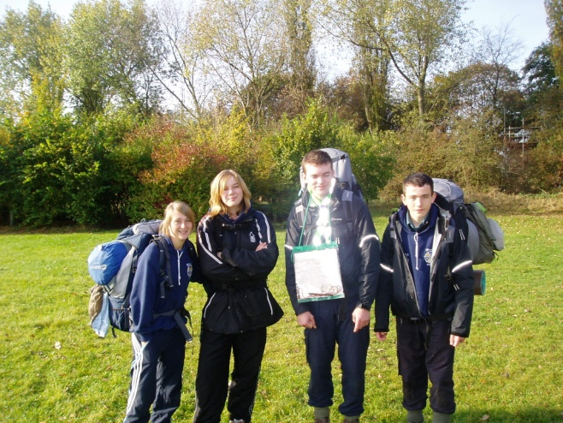
Duke of Edinburgh
Bronze Award
Discovery ESSU

Slide 2
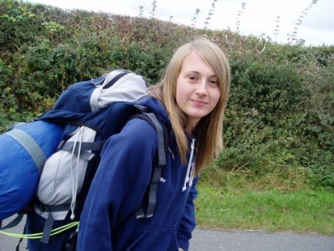
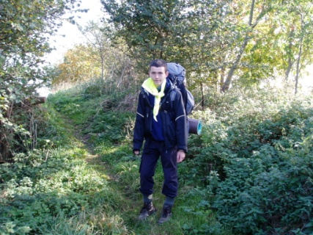
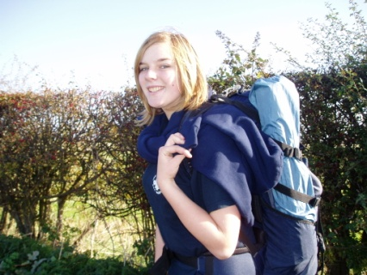
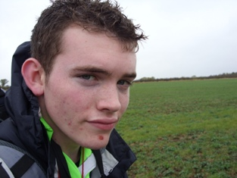
Abby
Michael
Hayley
Chris
The Team
Abby
Michael
Hayley
Chris
The Objective:
Navigate successfully from Belvoir Castle , camping overnight at Eaton ; to Colston-Bassett church.
Aim:
Collect information on churches en route.

Slide 3
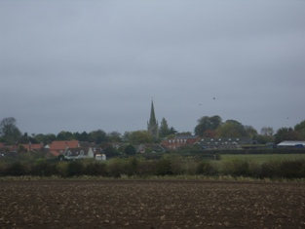
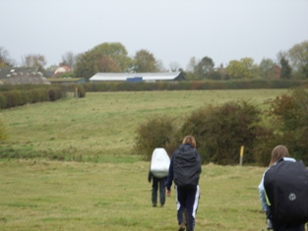
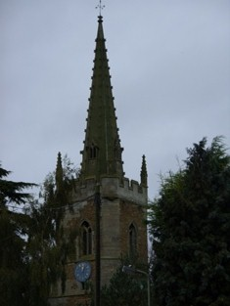
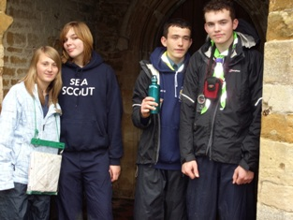
Day 1 – 24/10/2009
Navigate successfully from Belvoir Castle to Eaton to camp overnight.
Church: 1 - St. Peter’s church Redmile.
“A recent survey of memorials in St. Peter’s churchyard Redmile has identified eight stones which pose a danger to visitors to the churchyard”

Slide 4
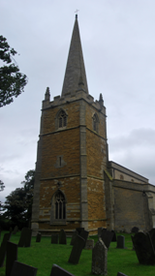
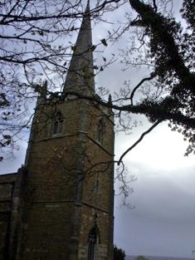
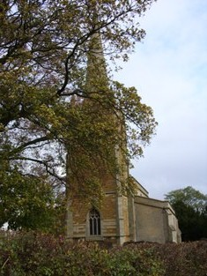
Church: 2 - St Peter & St Paul's Barkestone.
“Ironwork of the gate originally made by Geoge Mackley, 1919-2002” .

Slide 5
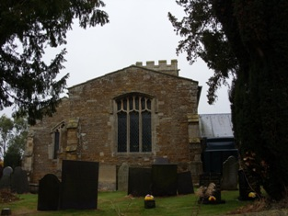
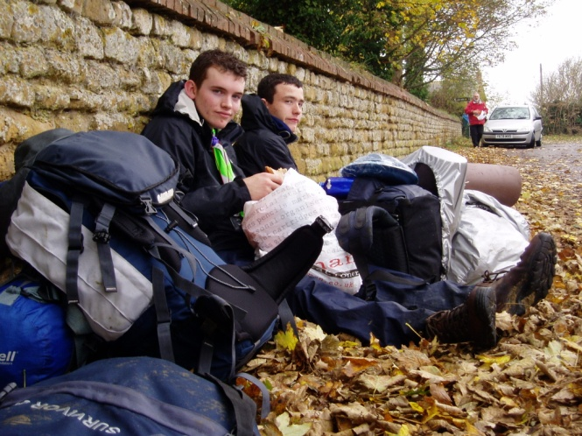
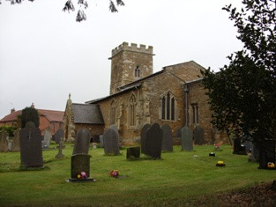
“The church is normally open for private prayer & contemplation. In the event of finding it locked, keys are available from Mrs. Cross.”
As we decided to look at this church and have lunch outside it, we also thought it a good idea to keep sheltered from the rain.
Church: 3 - St.Helen’s Church Plunger.

Slide 6
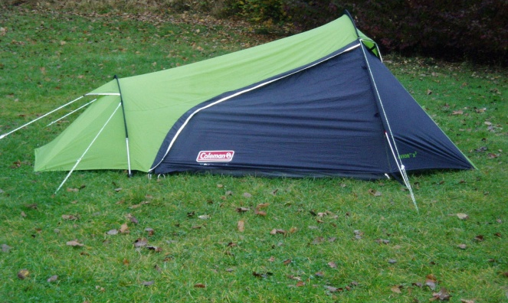
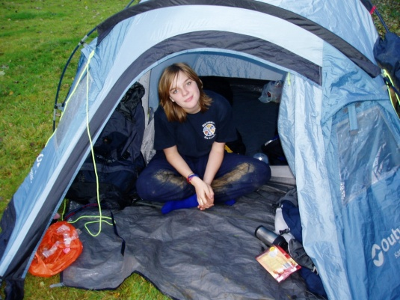
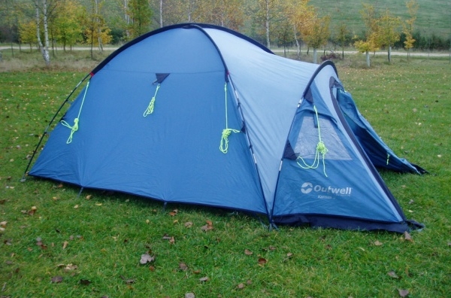
Where we camped ?
After our first day of walking we finally reached our camping site which was Castle Inn Pub, Eaton.
We decided to take two tents as its was easier to carry because you could split a tent between the two people sharing it.
One of the tents was for Michael and Chris. The other tent was for Abby and Hayley.

Slide 7
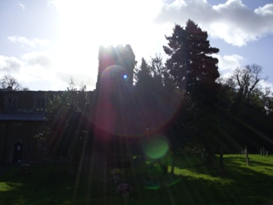
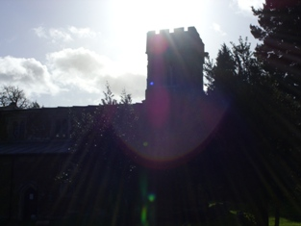
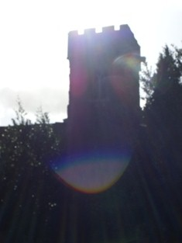
Day 2 – 25/10/2009
Navigate successfully from Eaton campsite to Colston- Bassett church.
Church: 4 - St.Michael and all Angel’s Church, Eastwell.
“Belongs to the “Ironstone” Family group of churches.”

Slide 8
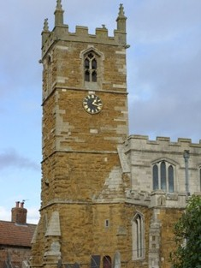
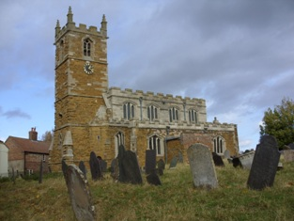
Church: 5 - St.Michael and all Angel’s Church, Hose.

Slide 9
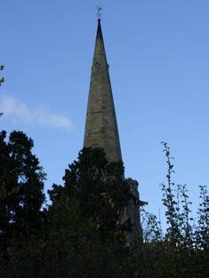
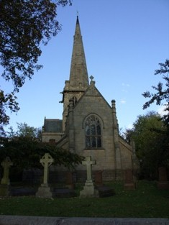
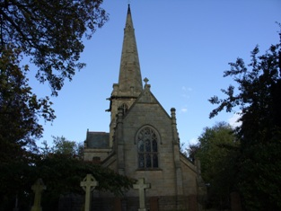
“Part of the Wiverton group of parishes: Cropwell Bishop, with Colston Bassett, Granby with Sutton and Elton.
Langar cum Barnstone, and Tythby with Cropwell Butler.”
1st Sunday: 10:00am Group All-age. Holy Communion at St. Andrew Langar.
2nd Sunday: 8:00am Holy Communion (BCP, Said)
3rd Sunday: 11:00am Morning worship
4th Sunday: 4:00pm (winter) or
5th Sunday: 10:00am & 6:00pm (summer) Evening Prayer
For details of other services check porch.
Church: 6 -
St. John The Divine, Colston-Bassett.

Slide 10
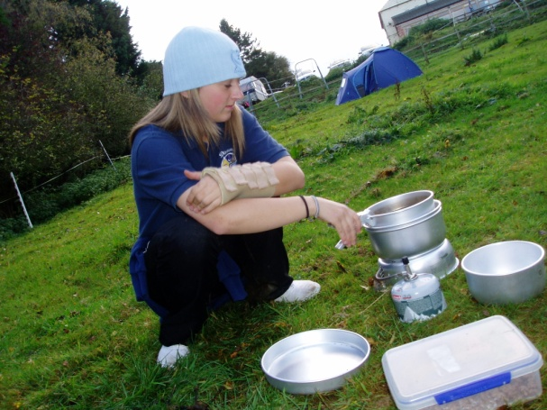
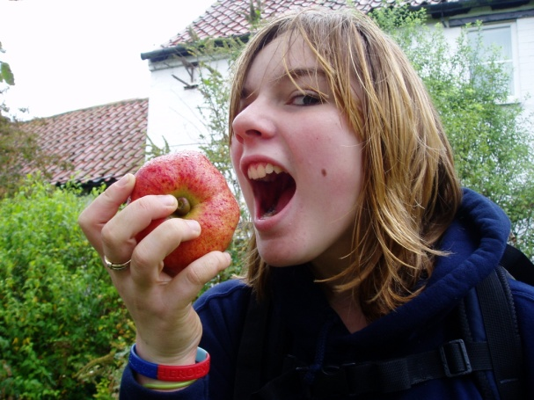
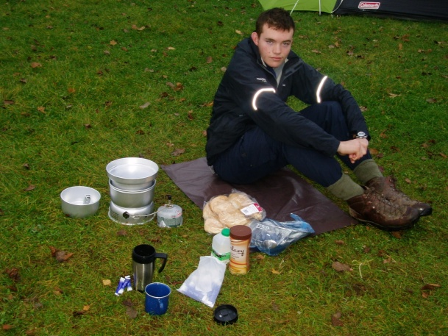
What did we eat ?
Day 1-
Lunch – home made sandwiches with snacks.
Dinner – Spaghetti bolognaise.
Day 2-
Breakfast- bacon cobs with bean and sausages.
Lunch -home made sandwiches with snacks.
We had tea, hot chocolate and juice.

Slide 11
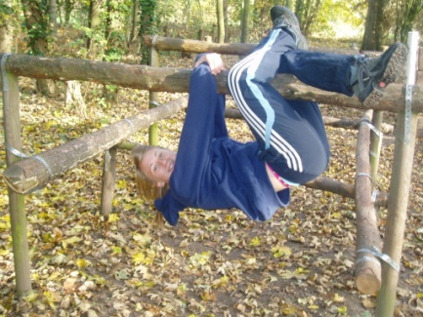
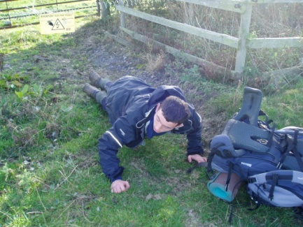
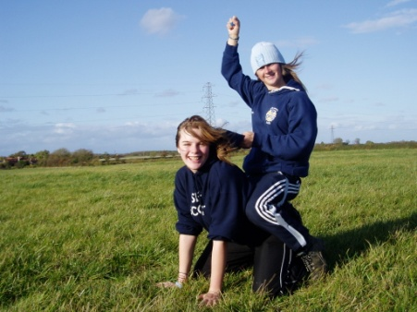
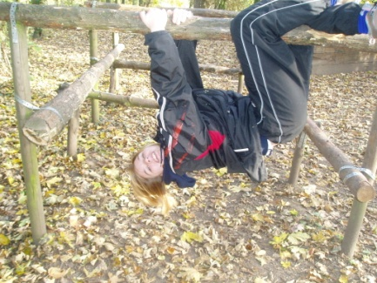
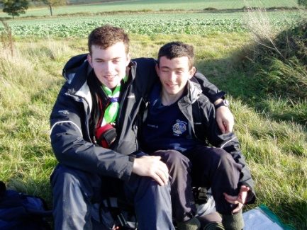
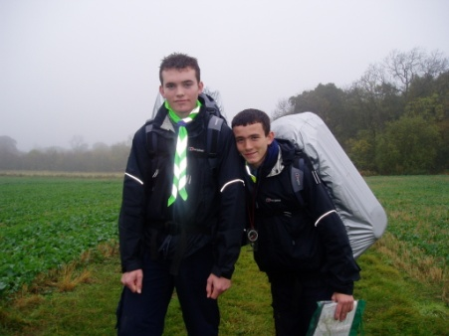
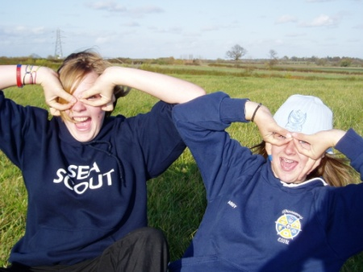
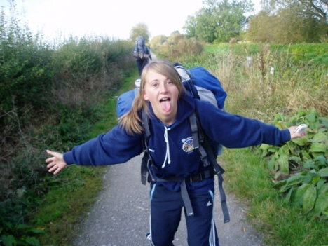
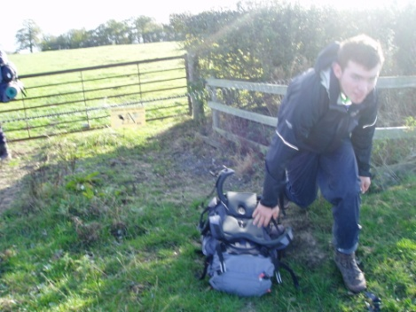
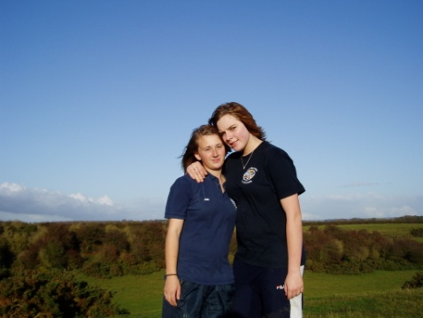
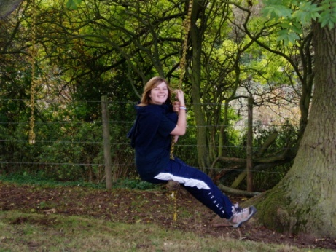
You can always have FUN when walking!

Slide 12
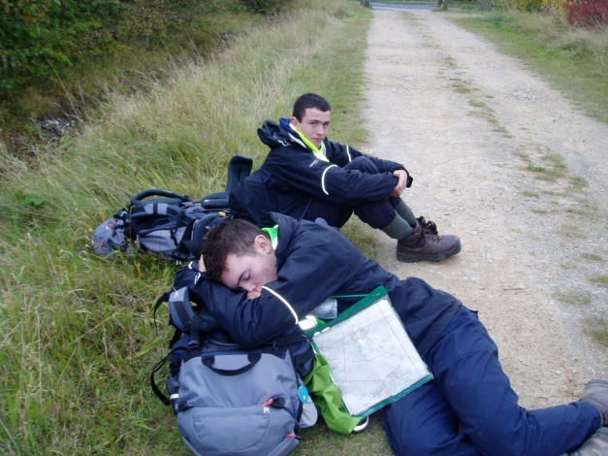
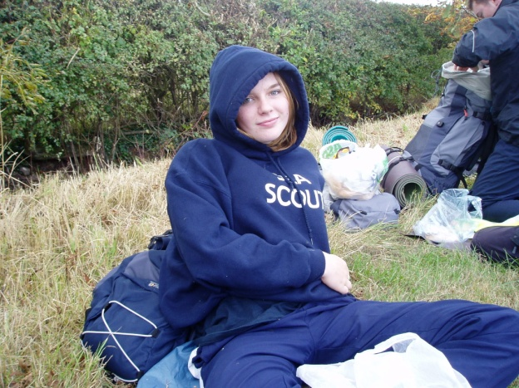
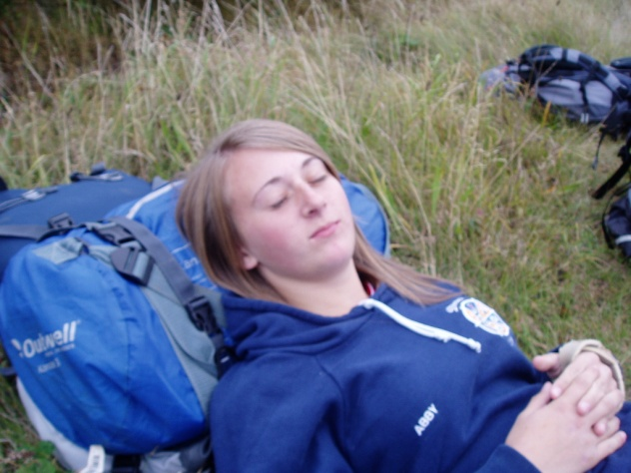
After the walk!
Tired… sore backs … blisters and just general pain!
But most of all We’re VERY PROUD of our achievement!

